Slide 1

Final Project: San Diego Airbnb Analysis
IST707
Zequn Che & Jiyu Feng

Slide 2
Agenda
Background
Dataset Summary
Mining Tasks
Project Plan

Slide 3
Background
Full name: AirBed and Breakfast
Arrange homestays or tourism experiences.
Acts as a broker
Online booking

Slide 4
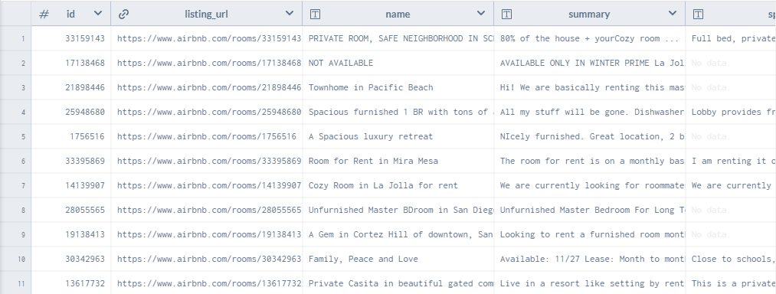
Dataset
San Diego Airbnb Data
All active Airbnb listings in San Diego, download from Inside Airbnb
Notes:
Has 75 attributes and 13051 records

Slide 5
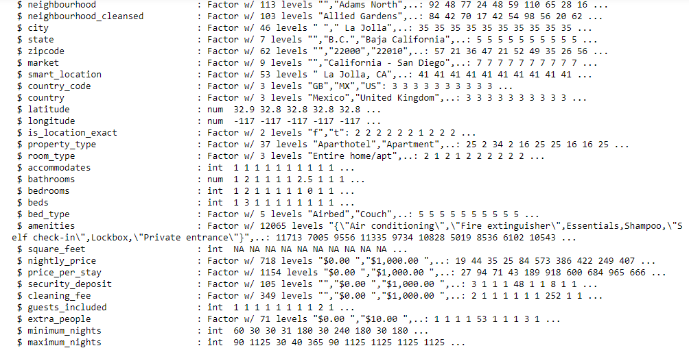
Dataset

Slide 6
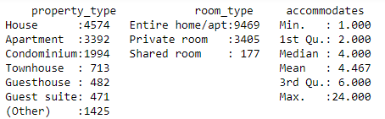
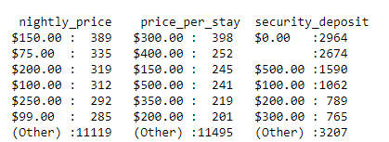
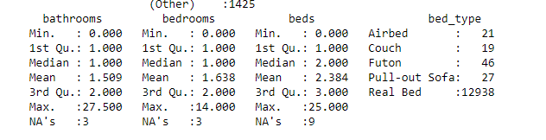
Dataset

Slide 7
Mining Tasks
Association Rule:
which attributes determine the price: low or high

Slide 8
Mining Tasks
SVMs and Decision Tree:
Price Prediction

Slide 9
Process Plan
Clean data
Explore data & visualization
Association Rules for the price level
Price Prediction
Evaluation of outcomes

Slide 10
References
https://www.bbc.com/news/technology-50315546
https://data.world/ajsanne/san-diego-airbnb
https://en.wikipedia.org/wiki/Airbnb

Slide 11
Thank you!

